Slide 1
Network PC Monitoring and Control
Presented By - Karki Mansi Khadak
Salgude Vaishnavi Pravin

Slide 2
Agenda
Introduction
System Architecture
Modules
Advantages
Application
Future Scope
Conclusion

Slide 3
Introduction
The Network PC Monitoring and Control is a Network application which is created for managing Client System which Connected with Server.
This project is expected to limit human works and make system handling easier for student and Lab operator with the help of the network application to Lab, Connect The multiple clients with single server system
System get always informed when client do any certain activity.

Slide 4
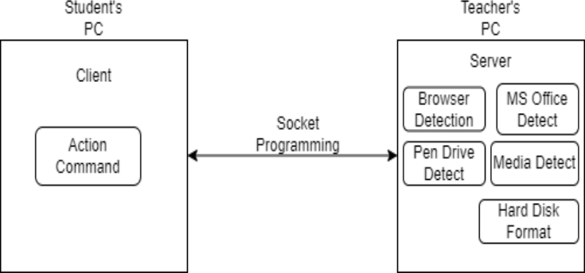
System architecture

Slide 5
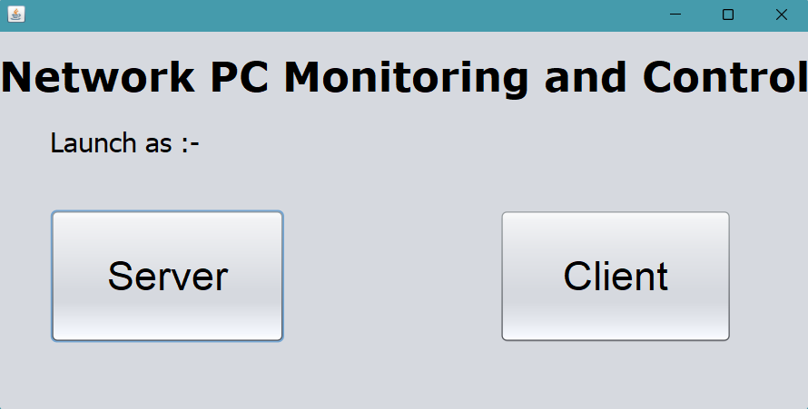
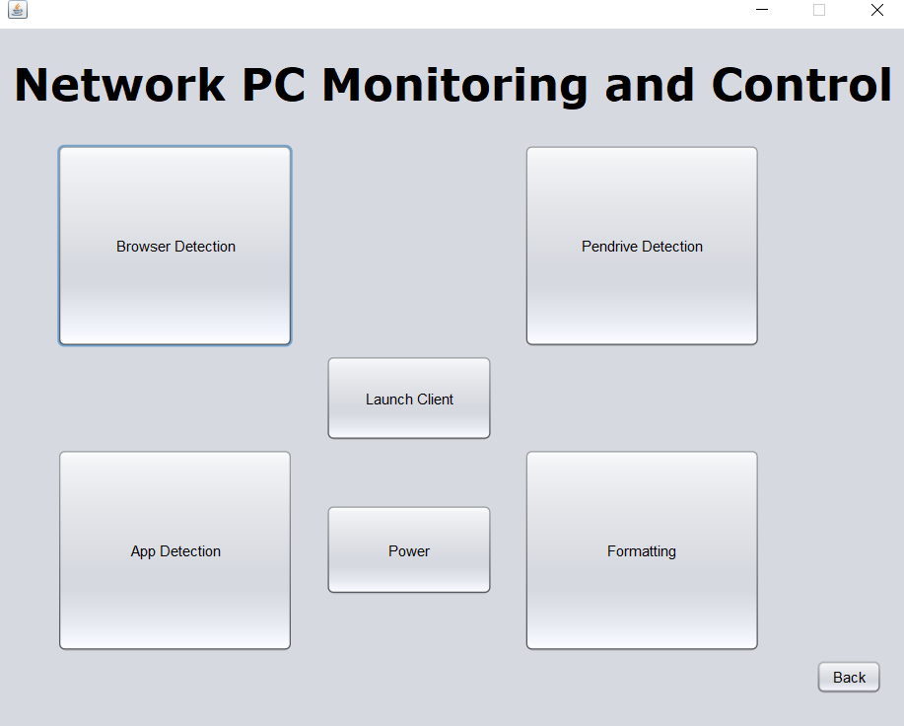
Modules (User)
Home Page:
Client Login:

Slide 6
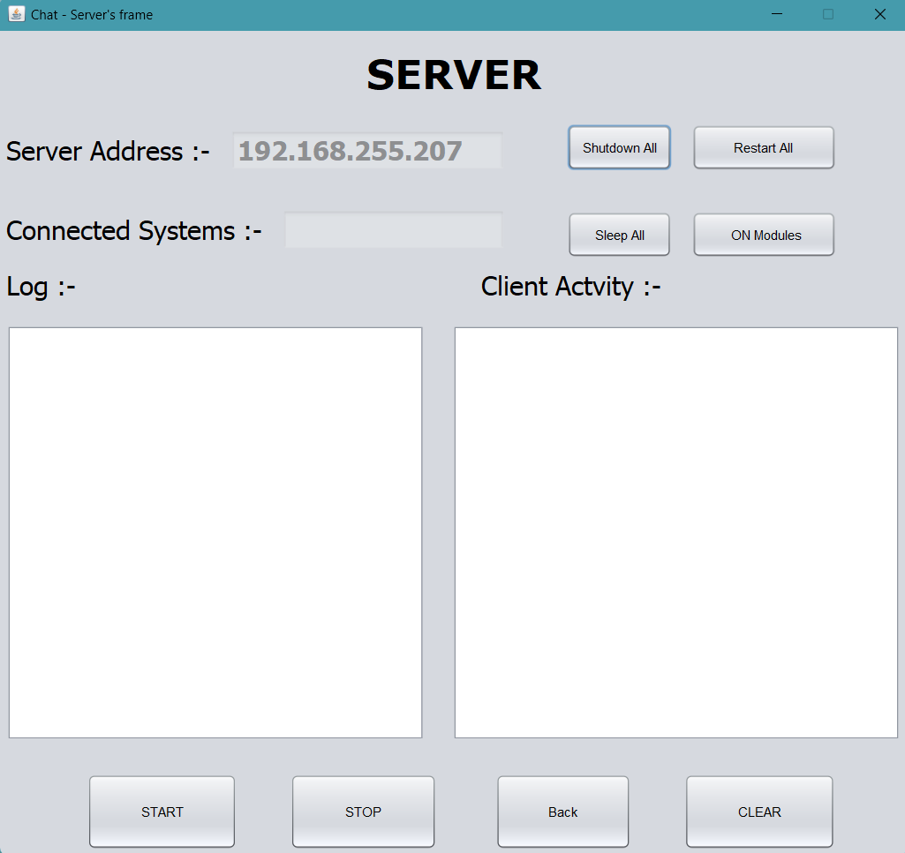
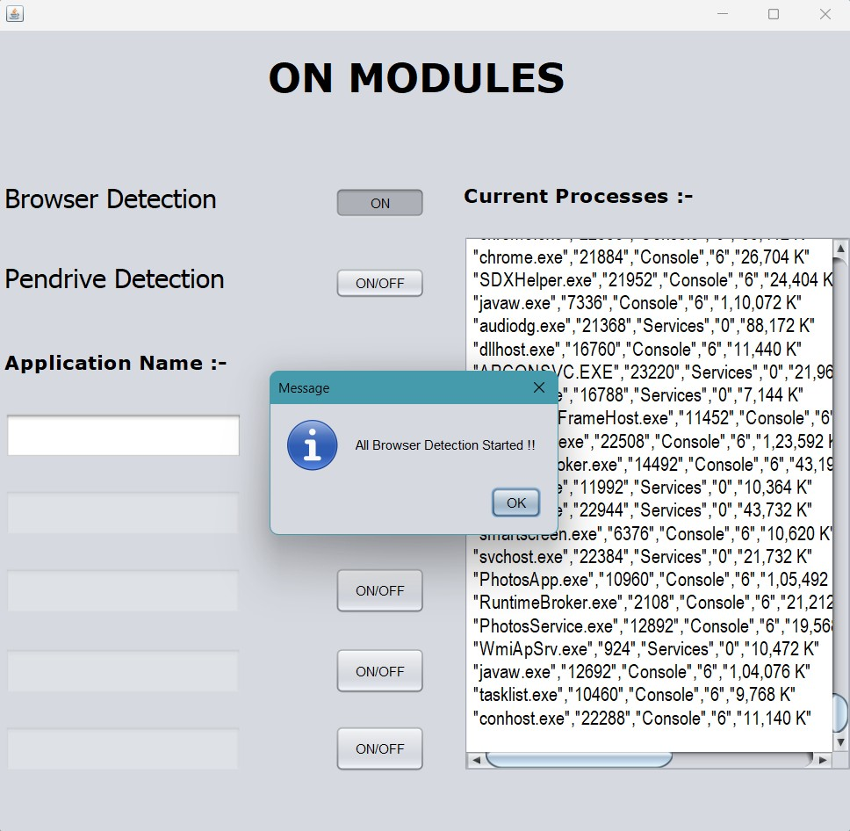
Modules (SErver)
Server Login:
Browser Detection:

Slide 7
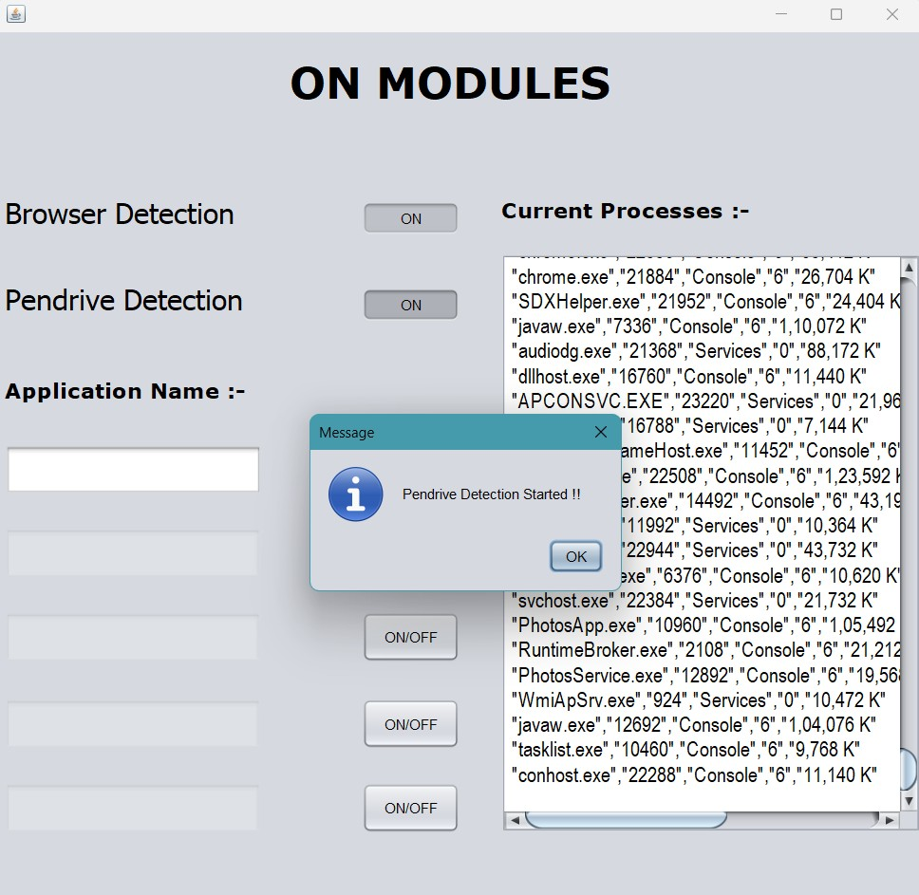
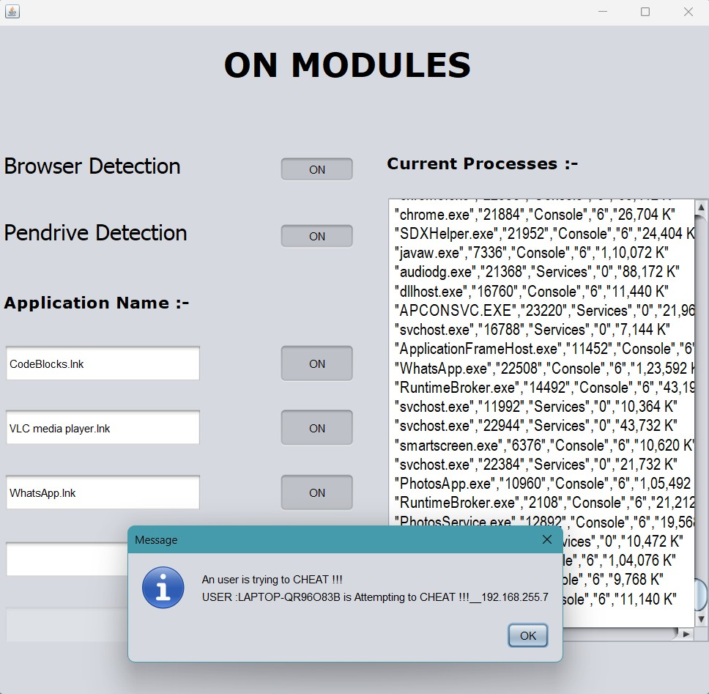
Pendrive Detection:
Pop-up cheated msg :

Slide 8
Advantages
The lab monitoring system provides real-time monitoring of lab machines and processes, making it easier for admins to manage the lab environment.
The system allows admins to remotely shut down, restart, and sleep client machines, reducing power consumption and increasing system lifespan.
The system has a user-friendly interface that is easy to use and navigate, improving user satisfaction and productivity.

Slide 9
Application
In Educational institutes
It is used for the security in colleges, schools, and universities.
In Companies / Industries
It is used for the security in software companies, industries.
To save students by tracking their attendance.

Slide 10
Future Scope
The users suggest that the future research may improve the current project.
More features may also be added to the system through future research to improve and enhance the capabilities of the system.
Future research may also create a mobile application on iOS or android due to which the system will be more easily accessible and may accommodate and support more users that use different mobile platforms.
As the result provide more security.

Slide 11
Thank You

